Slide 1
Group 2
Krysta Valenzia, Druv Narain, Max Moore, Ola Ajala, Angina Shrestha, Caitlin nanashko, Kenny vu

Slide 2
Team Members Roles and Responsibilities
Krysta Valenzia – Coordinator, Requirements, HLA Diagram, Meetings/Updates from Professor
HTML/CSS Programmer
Druv Narain – Documenter, Use Cases, Requirements, Diagrams (HLA, Sequence, Class and Interface), Task List
Java Programmer
Max Moore – Created Repository
Java Programmer, Snapchat API
Ola Ajala – Use Cases, Requirements, Login Template
Game Programmer
Angina Shrestha – Use Cases, Requirements
HTML/CSS Programmer
Caitlin Nanashko – Use Cases, Requirements
Game License, Database Design
Kenny Vu – Use Cases, Class Diagram
Game Programmer

Slide 3
Summary of Weekly Deliverables (so far)

Slide 4
Game Specs
Web Browser Based
Integrate exam questions with the game
**Screenshot of game from Caitlin**
Social Media: Trying to find Snapchat API

Slide 5
Group Collaboration
GroupMe
GoogleDocs
Github
Weekly Meetings (online and in person)

Slide 6
Challenges Faced
EVERYTHING
Learning web architecture
Integrating multiple programming languages
Creating Repositories

Slide 7
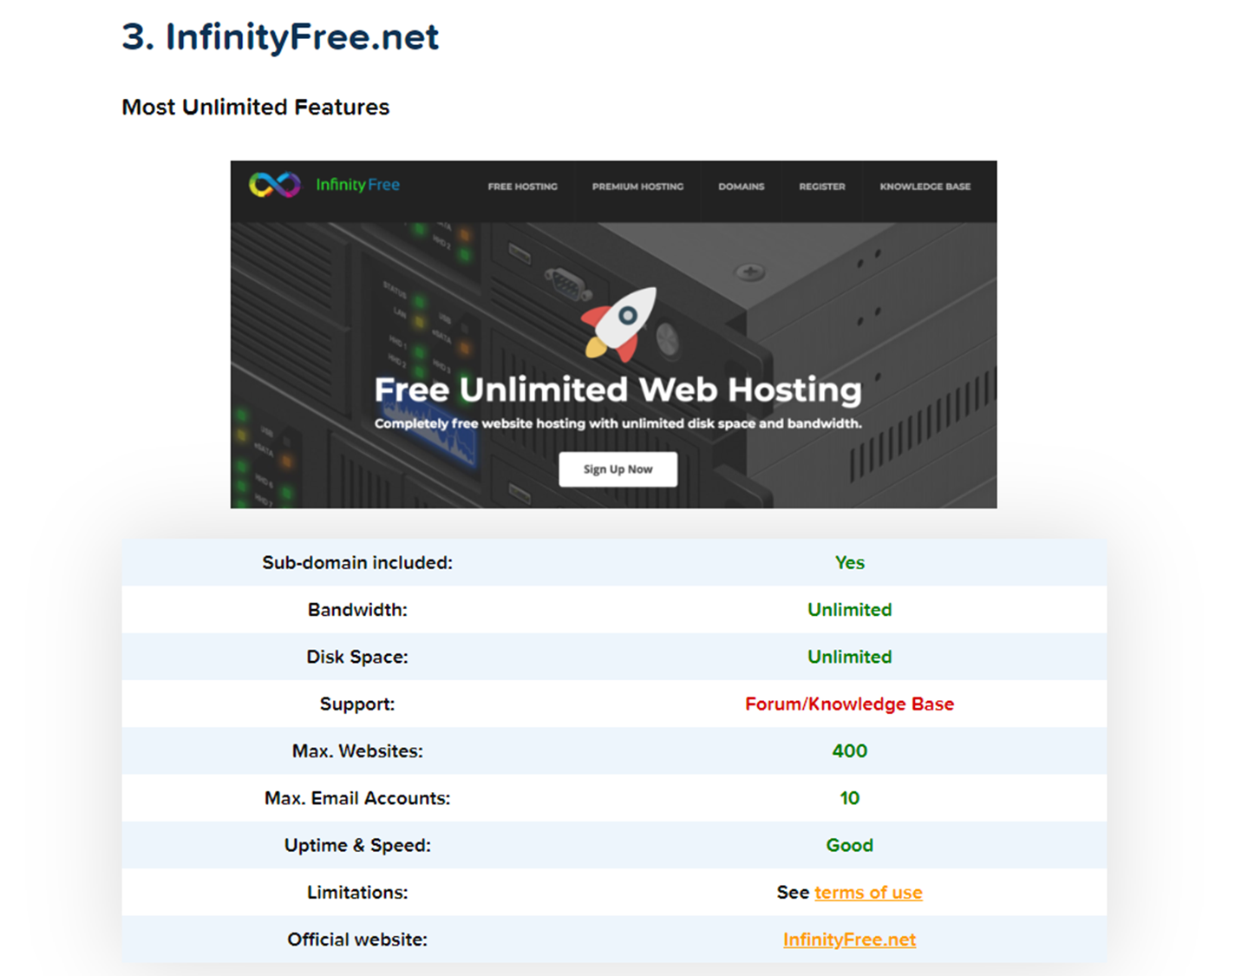
Web Host
Pros:
Free SSL certificate with all plans
No front-end ads
Free CloudFlare CDN
10 email accounts
1 FTP account
Unlimited bandwidth and storage space
400 MySQL databases.
Cons:
What does unlimited mean?
The penalty for non-compliance with the limitations on their “unlimited” offer is the suspension or elimination of your website and data.

Slide 8
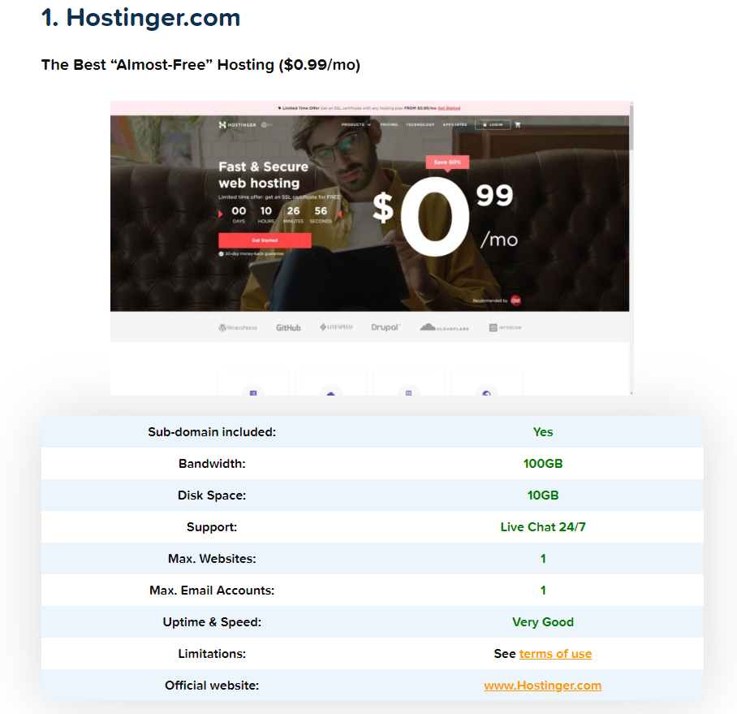
Back up Web Host - Hostinger.com
Pros:
1 MySQL database
1 FTP user
Access to their website builder
One-click install of WordPress or other CMS
A free domain name for 1 year
24/7 customer support (seriously, it’s one of the best)
100GB of Bandwidth and 10GB of Disk Space
One free email account
Cons:
Their user interface doesn’t give you access to a classic cPanel

Slide 9
Overview of Technologies
WordPress – has built in solutions, will build database, has several API’s, still customizable
Java – widely utilized programming language, entire group is familiar with it, game solution already built in java
HTML/CSS – language of the web
GitHub – simple user experience, some group members already familiar, share code easily and revert back if mistakes are made

Slide 10
Moving Forward
Building code
Developing Skeleton for Testing
Planning Code Review Process
Learning new technologies (HTML, REST API)
WebEx10 Host
Exam Questions

